Slide 1
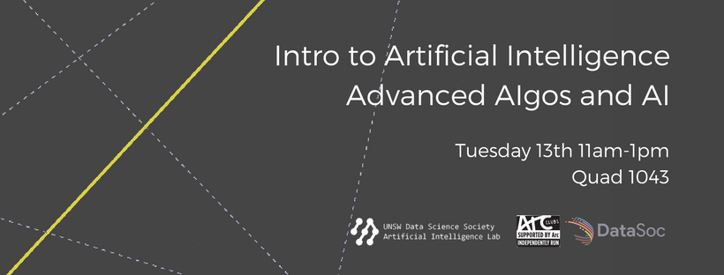
Daniel Han-Chen, Johnny Wong

Slide 2
Disclaimer + Legal Stuff
All content in these courses are for educational purposes only. UNSW’s Mathematics and Statistics School and any UNSW entity including the Data Science Society and ARC is not responsible for any misuse or usage of our material in any commercial or educational practice and endeavor. Any UNSW entity and the society will not be in any way responsible for any damages caused if you are attending or watching these lectures online / or in person.
2. We thank UNSW’s Mathematics and Statistics School for allowing us to provide these lectures free of charge to all students.
3. NO RECORDINGS allowed. Strict rules. Only the society can record any material. All material will be placed on YouTube. If you want to record, please ask us first for permission. If we say yes, you must note the original owners of these lessons.
4. We’ll try our best to acknowledge all work and materials that we use within our presentation. If we forgot about some, we’re terribly sorry. Please contact us, and we’ll place an acknowledgement to the original author.
UNSW Data Science Society
Artificial Intelligence Lab

Slide 3
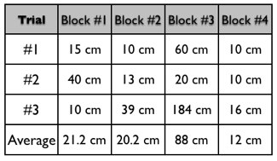
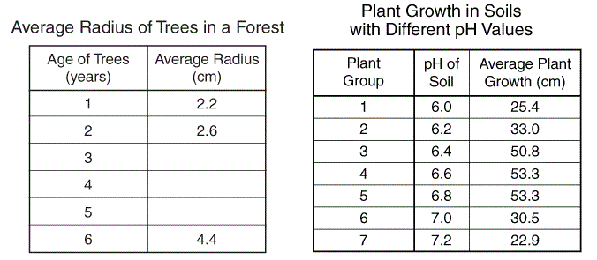

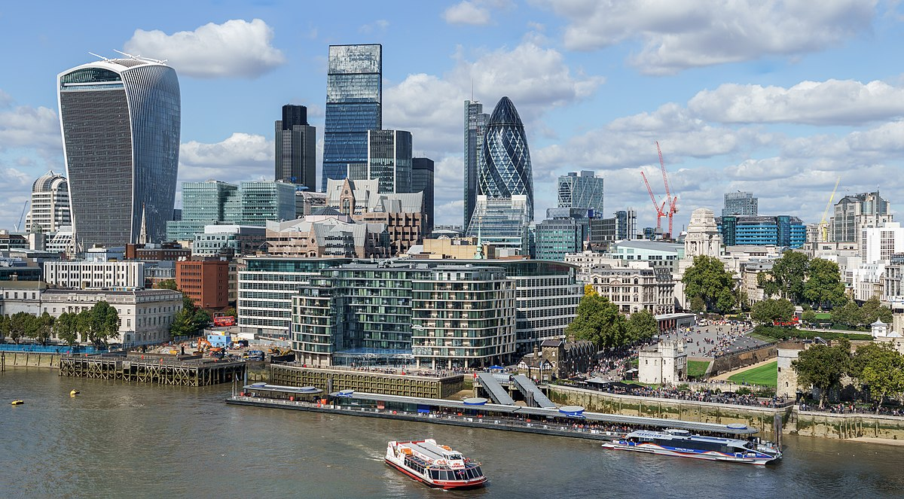
Data?
UNSW Data Science Society
Artificial Intelligence Lab

Slide 4
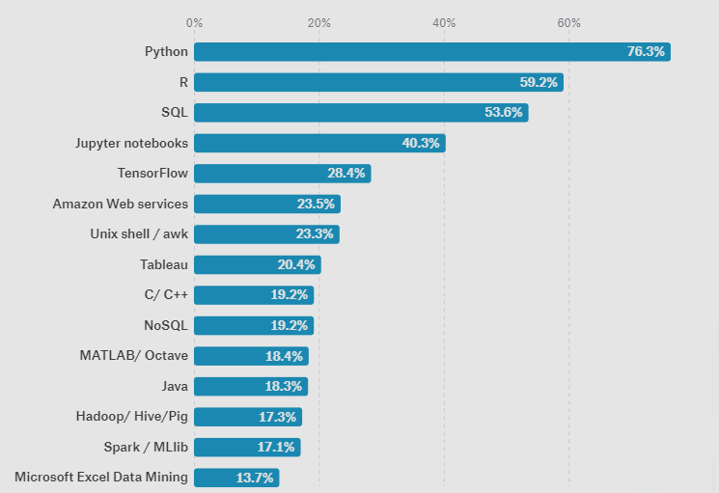
Machine Learning V Data Visualization
Blue = Graphing capabilities
Thick Blue = Lots of Graphing capabilities
Green = Host for graphing
UNSW Data Science Society
Artificial Intelligence Lab
https://www.kaggle.com/surveys/2017

Slide 5
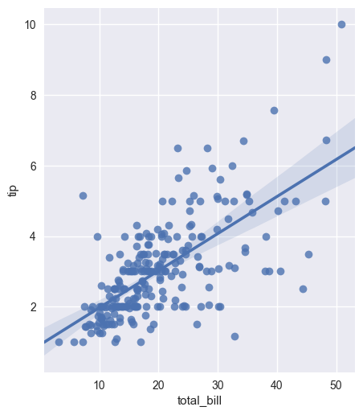
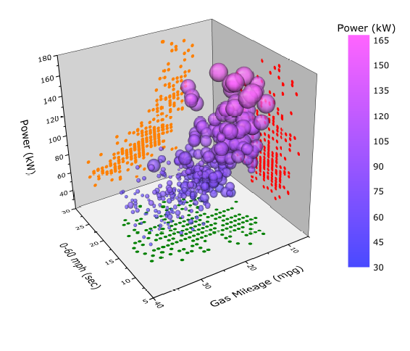
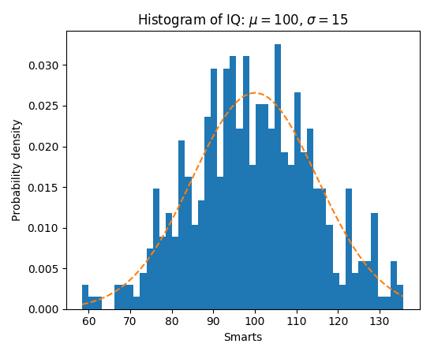
Data Visualizations
UNSW Data Science Society
Artificial Intelligence Lab

Slide 6
Exploring Data + Data Visualization
Dimension of data | Graph Choice
1 Column | Histogram
2 Columns | Scatter Line Plot
3 Columns | 3D Scatter Line Plot
4 Columns | 3D Scatter Line Plot + Colour Coded
5+ Columns | Dimensionality Reduction
UNSW Data Science Society
Artificial Intelligence Lab

Slide 7
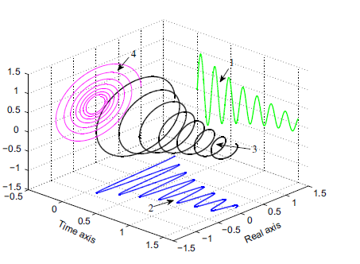
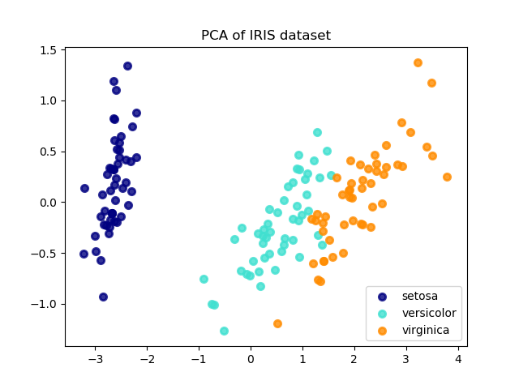
Exploring Data + Data Visualization
1 | 2 | 3 | 4 | 5+
UNSW Data Science Society
Artificial Intelligence Lab

Slide 8
Why is data visualization important?
Fast pattern recognition
Outliers
Variable Interactions
Intuitive Understanding of data
Used to explain models
UNSW Data Science Society
Artificial Intelligence Lab

Slide 9
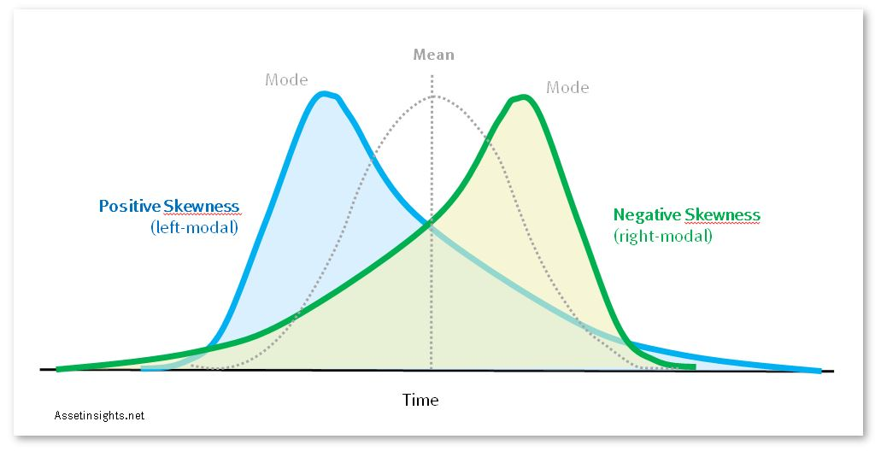
Some visualization concepts
Skewness
UNSW Data Science Society
Artificial Intelligence Lab

Slide 10
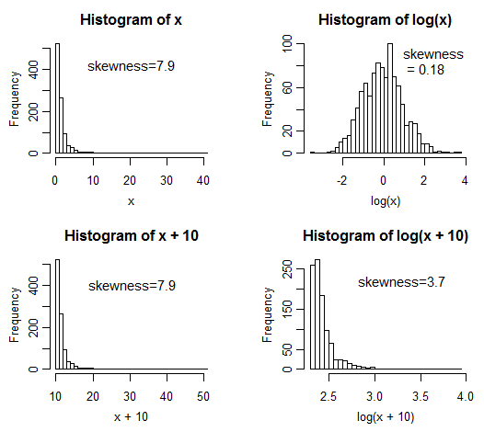
Some visualization concepts
2. Methods to unskew (log, sqrt)
UNSW Data Science Society
Artificial Intelligence Lab

Slide 11
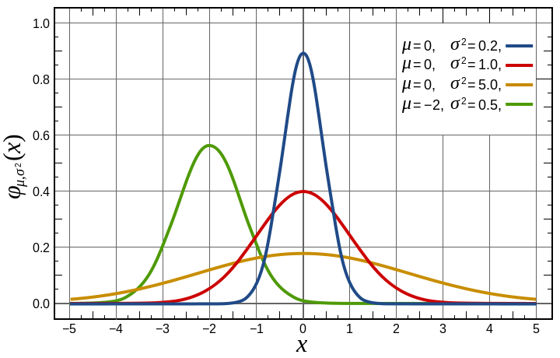
Some visualization concepts
3. Normal Distribution
UNSW Data Science Society
Artificial Intelligence Lab

Slide 12
Daniel Han-Chen, Johnny Wong

Slide 13












…
…
Singular Value Decomposition SVD
$$X=UV^{T}$$
Eigendecomposition
Markov Systems
$$X=VΛV^{T}$$
$$X^{θ}=VΛ^{θ}V^{T}$$
Pseudoinverse
$$X^{+}=V^{+}U^{T}$$
…
Principal Component Analysis PCA
$$PCA_{0:c}=sort{\left(∑ in U∑V^{T}\right)}_{0:c}$$
…
Linear Regression
$$\hat{θ}=X^{+}y$$
$$\hat{σ}=\frac{||y−\hat{y}||}{n−d}$$
Lasso Regression (L1)
$$θ_{L1}\sim \min{||y−\hat{y}||} +λ_{L1}|θ_{L1}|$$
Weighted Linear Regression
$$θ_{WLS}={\left(X^{T}WX\right)}^{−1}X^{T}Wy$$
Confidence Intervals
$$\hat{θ}±t_{1−\frac{α}{2},n−d}\hat{σ}\sqrt{diag\left(V∑^{2+}V^{T}\right)}$$
Ridge Regression (L2)
$$θ_{L2}\sim \min{||y−\hat{y}||} +λ_{L2}\left|\left|θ_{L1}\right|\right|$$
$$θ_{L2}={\left(X^{T}X+λ_{L2}I\right)}^{−1}X^{T}y$$
Generalized Linear Regression
$$θ_{GLS}= {\left(X^{T}∑^{−1}X\right)}^{−1}X^{T}∑^{−1}y$$
Prediction Intervals
$$\hat{y_{i}}±t_{1−\frac{α}{2},n−d}\hat{σ}\sqrt{1+x_{i}\left(V∑^{2+}V^{T}\right)x_{i}^{T}}$$
…
Elastic Net Regression (L1, L2)
$$θ_{ENet}\sim \min{||y−\hat{y}||}+λ_{L1}|θ_{L1}|+λ_{L2}\left|\left|θ_{L1}\right|\right|$$
UNSW Data Science Society
Artificial Intelligence Lab

Slide 14







Generalized Linear Regression
$$θ_{GLS}= {\left(X^{T}∑^{−1}X\right)}^{−1}X^{T}∑^{−1}y$$
…
Gradient Descent
$$θ←θ−λ_{LR}C$$
Elastic Net Regression (L1, L2)
$$θ_{ENet}\sim \min{||y−\hat{y}||}+λ_{L1}|θ_{L1}|+λ_{L2}\left|\left|θ_{L1}\right|\right|$$
Activation Functions
$$a=σ_{sigmoid}=\frac{1}{1+e^{−x}}$$
Support Vector Machine
$$θ_{SVM}\sim \min{|φ_{SVM}}\left|+λ_{L2}\right||θ_{SVM}||$$
$$∀φ_{SVM}=\max{(0,1− <y,Xθ_{SVM}>)}$$
Logistic Regression
$\hat{y}=$ $σ_{sigmoid}(Xθ)$
…
…
Neural Network
$\hat{y}=a(…a(a(Xθ_{H1})$ $θ_{H2})…θ_{Hd})$
…
UNSW Data Science Society
Artificial Intelligence Lab

